Slide 1
Stock Price Analysis for
MSFT, Tesla, and Apple
Alaaeddin Osta

Slide 2
Table of Contents
I
II
III
IV
Project Scope
Descriptive Statistics
- Project Overview
- Objectives
- Output Summary
- Charts
Regression Analysis
Wrap Up
- Regression Summary Output
- Line Fit Plots
- Conclusion
- Thank You!

Slide 3
I
Project Scope

Slide 4
Project Overview
This project explores the stock performance of three prominent companies: Microsoft, Tesla, and Apple, spanning the period from 2018 to 2023.
Utilizing real-time data retrieved from Yahoo Finance, our aim is to deliver a clear and comprehensive analysis of the evolving stock prices for these companies over the specified timeframe.

Slide 5
Objectives
To perform descriptive statistics to offer a comprehensive understanding of the stock price trends for Microsoft, Tesla, and Apple.
To visualize stock price movements through charts and graphs, facilitating a more accessible interpretation of trends and identifying potential patterns or anomalies.
To conduct a regression analysis, exploring the relationship between the stock returns of each company and the broader market represented by the S&P 500 index.
To find Beta coefficients for each company based on the regression analysis, providing a quantitative measure of their relative risk compared to the market.
To compare and contrast the risk profiles, trends, and stability of Microsoft, Tesla, and Apple stocks over the analyzed period.
To empower investors with actionable insights derived from the analysis, aiding them in making informed decisions in the dynamic stock market environment.

Slide 6
II
Descriptive Statistics

Slide 7
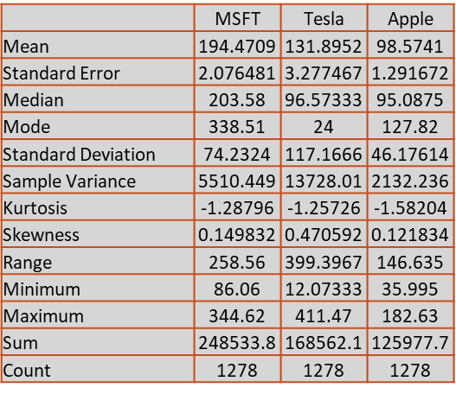
Output Summary
Microsoft has the highest mean stock price among the three companies.
All three stocks have a positive skewness, suggesting a rightward tail in their price distributions.
Apple has the lowest standard deviation, signifying that Apple's stock prices are the most stable.
Microsoft has the highest total return over the given period.
Tesla exhibits the highest standard deviation (117.17), indicating greater volatility and more significant price fluctuations compared to Microsoft and Apple.
Tesla also has the widest price range, which means higher variability in stock prices compared to Microsoft and Apple.

Slide 8
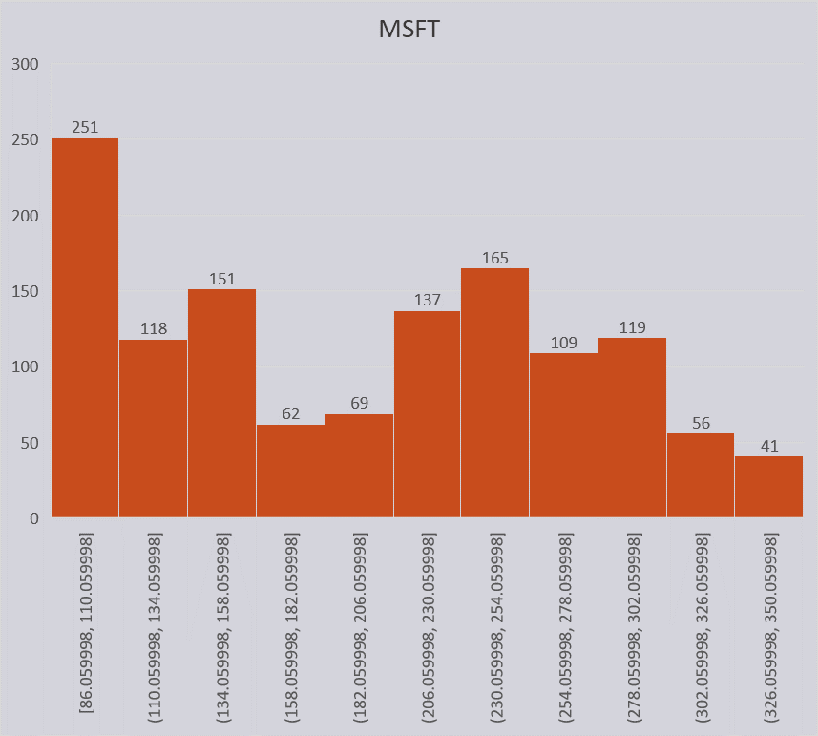
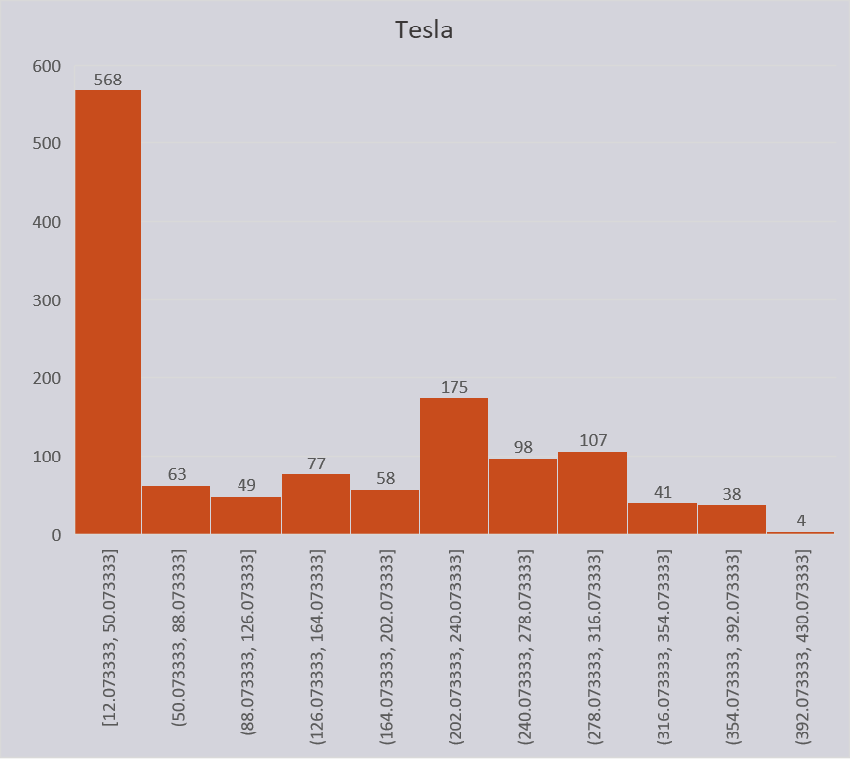
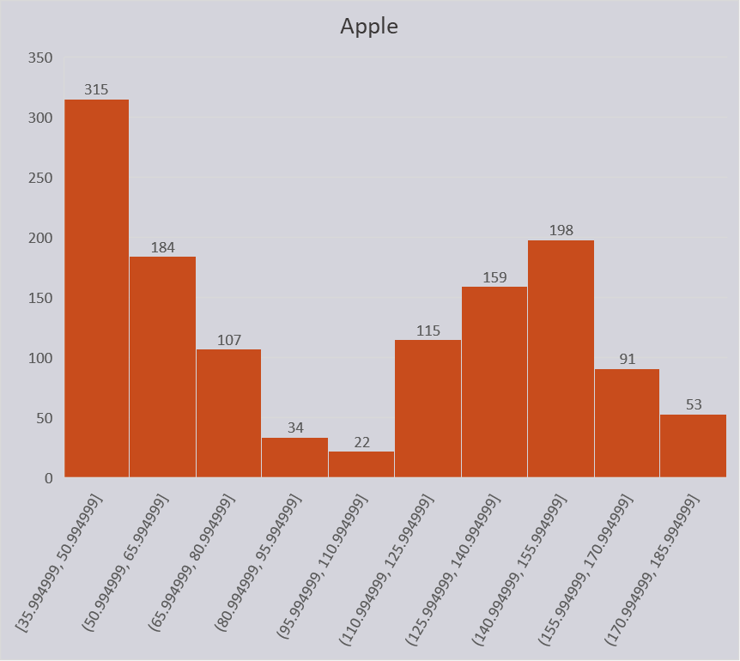
Charts
Upon examining the distributions, Microsoft's histogram appears more centered, Tesla's is wider with a more pronounced rightward tail, and Apple's is centered with moderate variability.

Slide 9
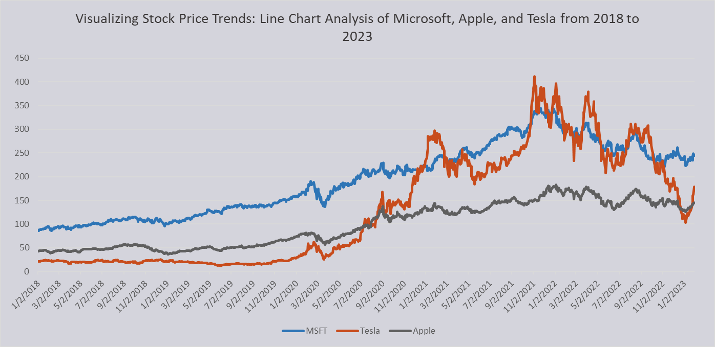
The year 2020 marked the commencement of an upward trend in stock prices for the three companies.
Tesla's stock prices underwent dramatic changes, particularly noticeable from the year 2020 onwards.
Apple demonstrates consistency in stock price movements from the year 2020 onward.

Slide 10
III
Regression Analysis

Slide 11
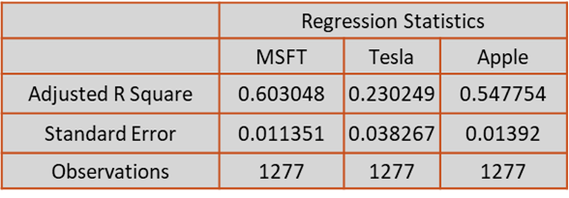
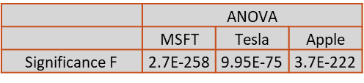
Regression Summary Output
All three companies (Microsoft, Tesla, and Apple) exhibit statistically significant regression models, signifying that market returns (SP%chng) play a crucial role in explaining the variability in their stock returns.
Microsoft and Apple show higher adjusted R Square values, suggesting a relatively stronger fit of their regression models compared to Tesla.
Tesla has the highest Beta among the three companies (Beta = 1.8178). It shows higher volatility, suggesting potentially higher returns but also higher risk.
Apple and Microsoft have somewhat similar market risk levels, with Apple slightly higher (Beta = 1.3292)

Slide 12
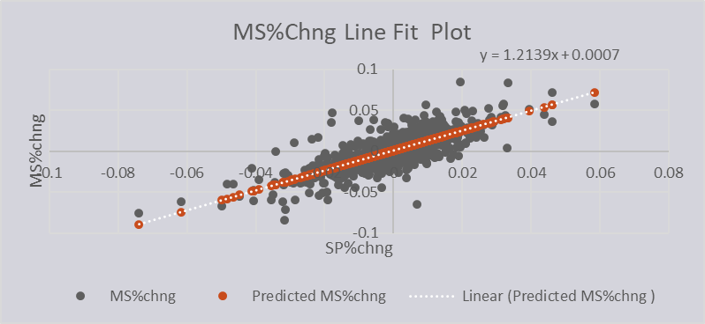
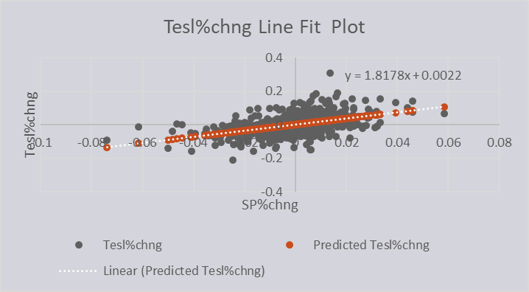
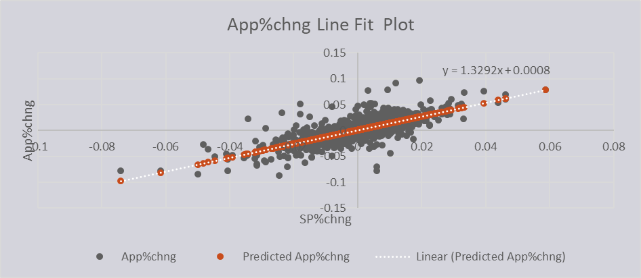
Line Fit Plots
Scatter Plots Analysis: Positive correlations are evident between the stock returns of Microsoft, Tesla, and Apple, and the Market Return (SP%chng)

Slide 13
IV
Wrap Up

Slide 14
Conclusion
Microsoft generally has a higher mean stock price and total return, making it a stable and profitable investment over the specified timeframe.
Tesla exhibits the highest volatility and price fluctuations, making it a riskier investment.
The positive skewness in all three stocks suggests a tendency for higher positive returns but with a potential for extreme positive values.
Apple has the most consistent performance in terms of stock price movements. Investors in Apple may experience a more steady and predictable pattern in stock price changes over the analyzed period.

Slide 15

Thank You!

